Slide 1

Research Report
Yunseob Shin,
Information & Intelligence System Lab., SKKU
2018/06/01

Slide 2
Contents
Feature Learning in Graphs
node2vec
LINE
Embedding Propagation
Ideas

Slide 3
Feature Learning in Graphs

Slide 4
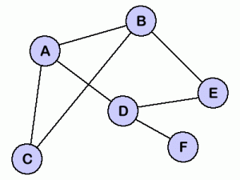
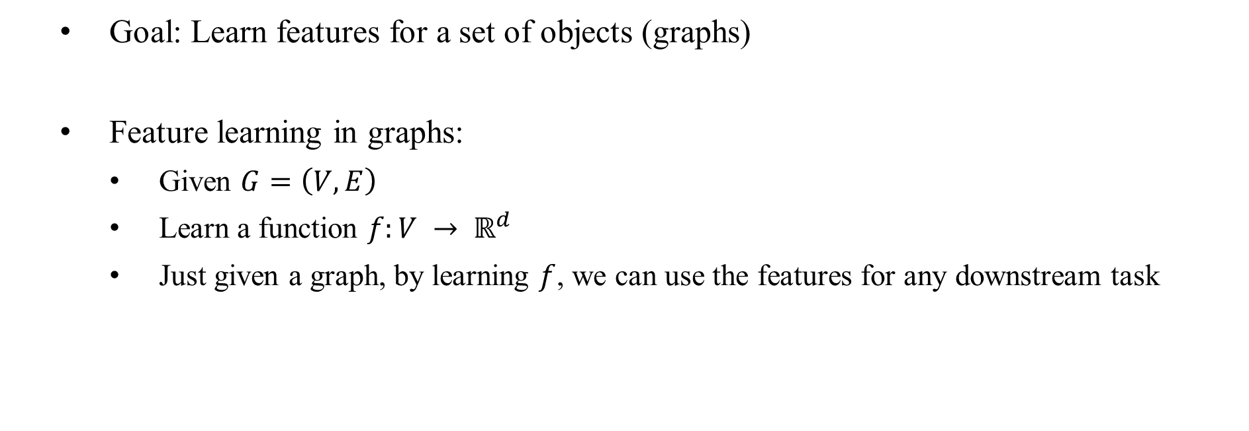
Feature Learning in Graphs
Goal: Learn features for a set of objects (graphs)
Feature learning in graphs:
Given $G=\left(V, E\right)$
Learn a function $f:V → ℝ^{d}$
Just given a graph, by learning $f$, we can use the features for any downstream task
A
B
C
D
E
F
Notes:
downstream task: learning algorithm, model

Slide 5
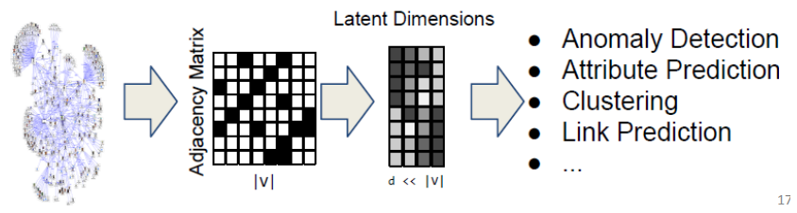
Feature Learning in Graphs
Why network embedding?
Mapping each node in a network into a low-dimensional space
Distributed representation for nodes
Similarity between nodes indicates link strength
Encode network information and generate node representation
Notes:
downstream task: learning algorithm, model

Slide 6
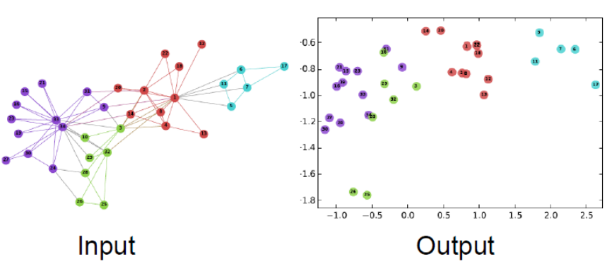
Feature Learning in Graphs
Example: Zachary’s Karate Club network

Slide 7
Feature Learning in Graphs
Why is it hard?
Images → fixed size → convolutions (CNN)
Texts → linear sequence → sliding window (word2vec)
Graphs → ?
Node numbering is arbitrary
Much more complicated structure

Slide 8
node2vec: Scalable feature learning for networks
Grover, Aditya, and Jure Leskovec. KDD, 2016

Slide 9
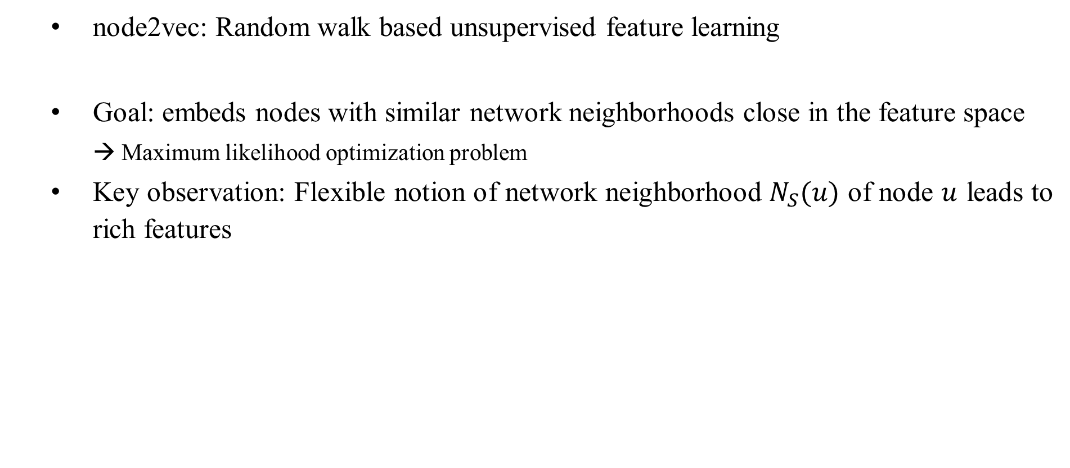
node2vec
node2vec: Random walk based unsupervised feature learning
Goal: embeds nodes with similar network neighborhoods close in the feature space
→ Maximum likelihood optimization problem
Key observation: Flexible notion of network neighborhood $N_{S}(u)$ of node $u$ leads to rich features

Slide 10

node2vec
Intuition: find embeddings of nodes to d-dimensions that preserve similarity
Idea: Learn node embedding such that nearby nodes are close together
Given a node u, we can define the “nearby nodes” as $N_{S}\left(u\right)$
$N_{S}(u)$: neighborhood of u obtained by some strategy S

Slide 11
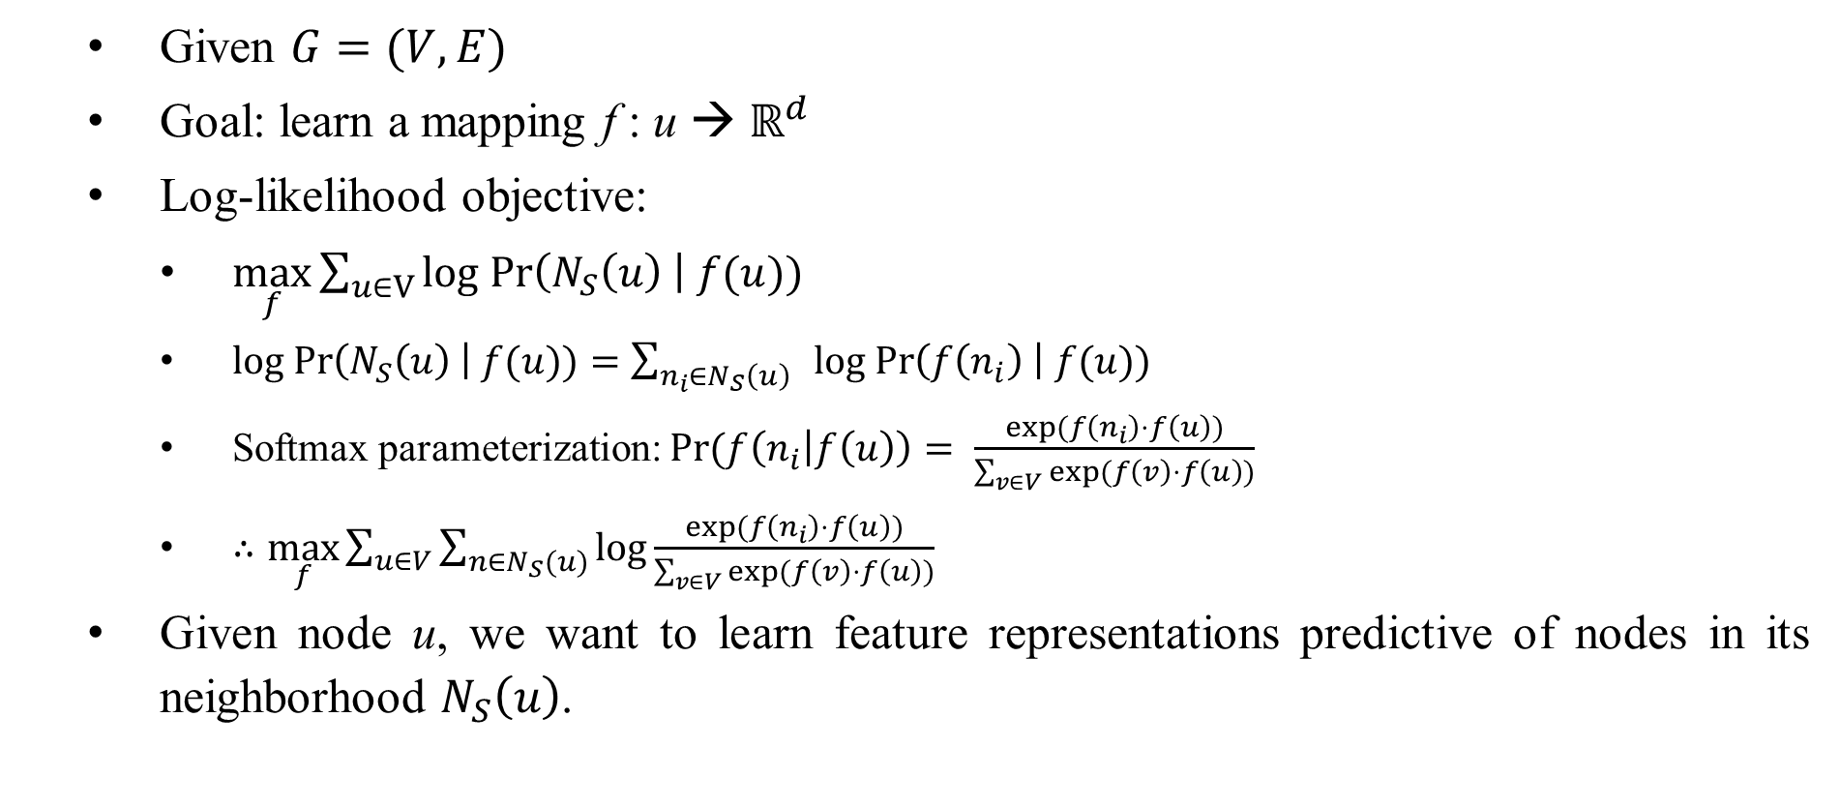
node2vec
Given $G=(V,E)$
Goal: learn a mapping f : u → $ℝ^{d}$
Log-likelihood objective:
$\max_{f}\sum_{u∈V}{log Pr\left(N_{S}\left(u\right) \right| f(u))}$
$log Pr\left(N_{S}\left(u\right) \right| f(u))=\sum_{n_{i}∈N_{S}\left(u\right) }{log Pr\left(f\left(n_{i}\right) \right| f(u))}$
Softmax parameterization: $Pr(f\left(n_{i} | f\left(u\right)\right)= \frac{exp(f\left(n_{i}\right)⋅f\left(u\right))}{\sum_{v∈V}{exp(f\left(v\right)⋅f\left(u\right))}}$
$∴\max_{f}\sum_{u∈V}{\sum_{n∈N_{S}(u)}{log}}\frac{exp(f\left(n_{i}\right)⋅f\left(u\right))}{\sum_{v∈V}{exp(f\left(v\right)⋅f\left(u\right))}}$
Given node u, we want to learn feature representations predictive of nodes in its neighborhood $N_{S}\left(u\right)$.

Slide 12
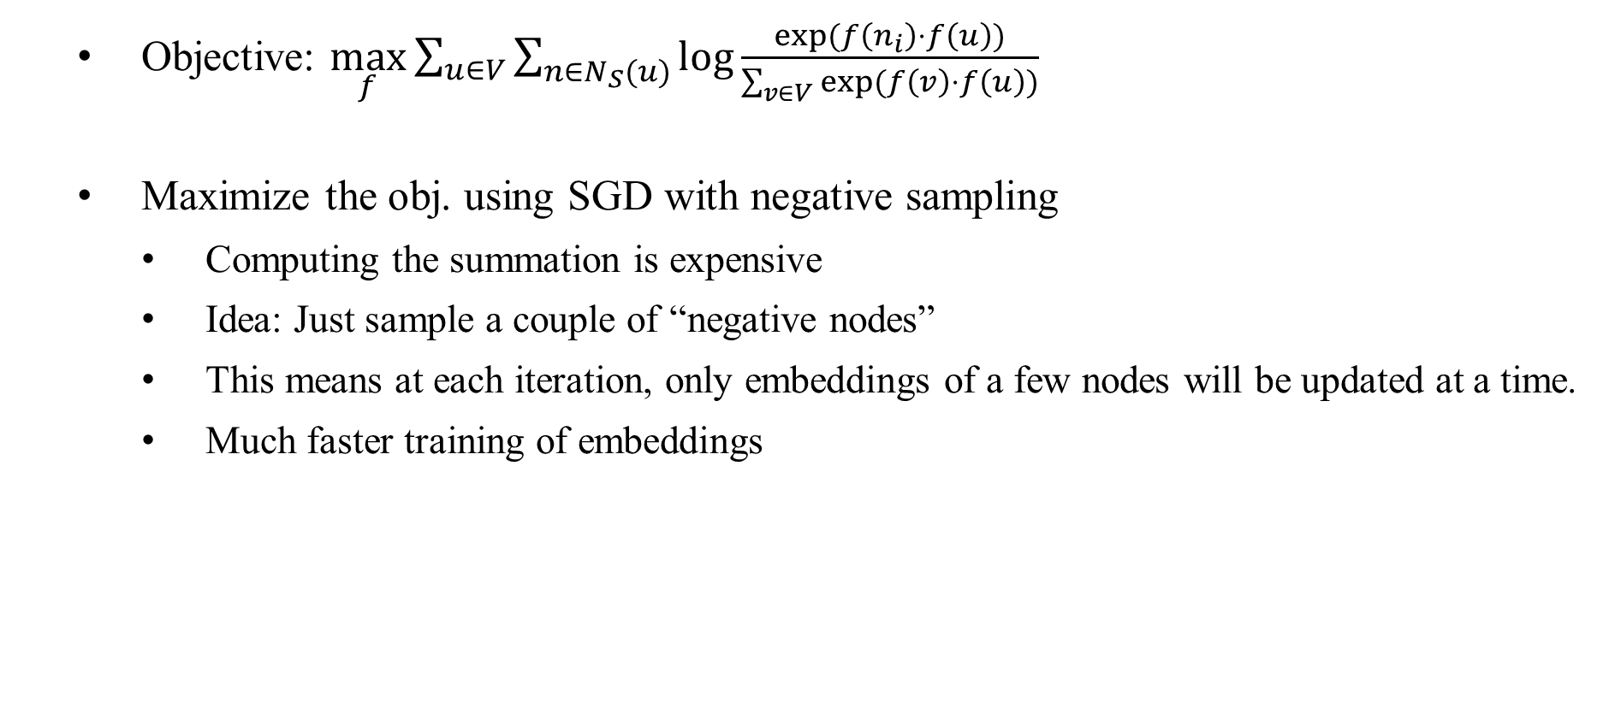
node2vec
Objective: $\max_{f}\sum_{u∈V}{\sum_{n∈N_{S}(u)}{log}}\frac{exp(f\left(n_{i}\right)⋅f\left(u\right))}{\sum_{v∈V}{exp(f\left(v\right)⋅f\left(u\right))}}$
Maximize the obj. using SGD with negative sampling
Computing the summation is expensive
Idea: Just sample a couple of “negative nodes”
This means at each iteration, only embeddings of a few nodes will be updated at a time.
Much faster training of embeddings

Slide 13
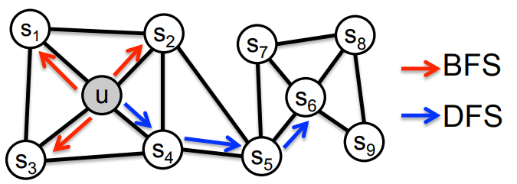

node2vec
How to determine $N_{s}(u)$
There are two classic strategies to define $N_{s}(u)$ of a given node u
$N_{BFS}\left(u\right)=\left\{s_{1},s_{2},s_{3}\right\}$ ➔ Local microscopic view
$N_{DFS}\left(u\right)=\left\{s_{4},s_{5},s_{6}\right\}$ ➔ Global microscopic view

Slide 14
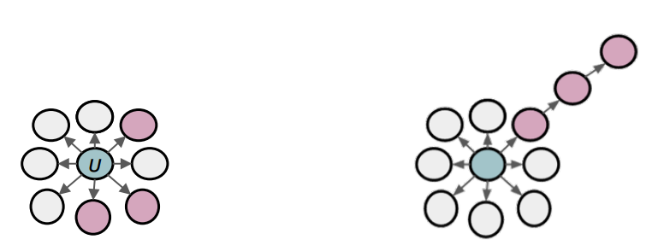
node2vec
BFS:
Micro-view of neighborhood
DFS:
Macro-view of neighborhood

Slide 15
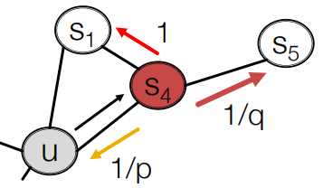
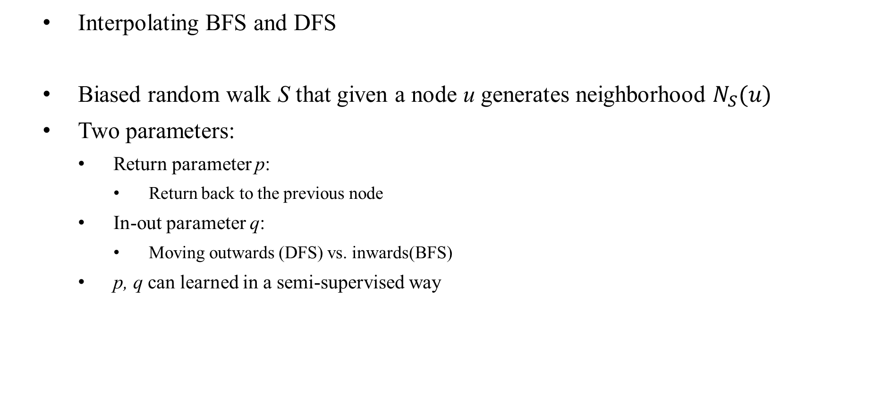
node2vec
Interpolating BFS and DFS
Biased random walk S that given a node u generates neighborhood $N_{S}(u)$
Two parameters:
Return parameter p:
Return back to the previous node
In-out parameter q:
Moving outwards (DFS) vs. inwards(BFS)
p, q can learned in a semi-supervised way

Slide 16
node2vec
node2vec algorithm
Compute random walk probabilities
Simulate r random walks of length l starting from each node u
Optimize the node2vec objective using SGD
Linear-time complexity
All steps are parallelizable

Slide 17
node2vec
General purpose feature learning in networks
An explicit locality preserving objective for feature learning.
Biased random walks capture diversity of network patterns.
Scalable and robust algorithm with excellent empirical performance
Future extensions would involve designing random walk strategies entailed to network with specific structure such as heterogeneous networks and signed networks.

Slide 18
LINE: Large-scale Information Network Embedding
Jian Tang et al. WWW, 2015

Slide 19
Large-scale Information Network Embedding
Problem: embedding information networks into low-dimensional spaces, in which every vertex is represented as a low-dimensional vector.
Such a low-dimensional embedding is very useful in a variety of applications such as visualization, node classification, link prediction and recommendation.
The paper proposed a scalable network embedding “LINE” which is suitable for arbitrary types of information networks
undirected / directed, weighted / not-weighted
Notes:
Motivation: nodes may have an arbitrary number of label types, and these label types may be heterogenous

Slide 20
Large-scale Information Network Embedding
Proposal 1: a scalable network embedding “LINE” which is suitable for arbitrary types of information networks with a carefully designed objective function that preserves first-order and second-order proximities.
Proposal 2: an edge-sampling algorithm for optimizing the objective.
Notes:
Motivation: nodes may have an arbitrary number of label types, and these label types may be heterogenous

Slide 21
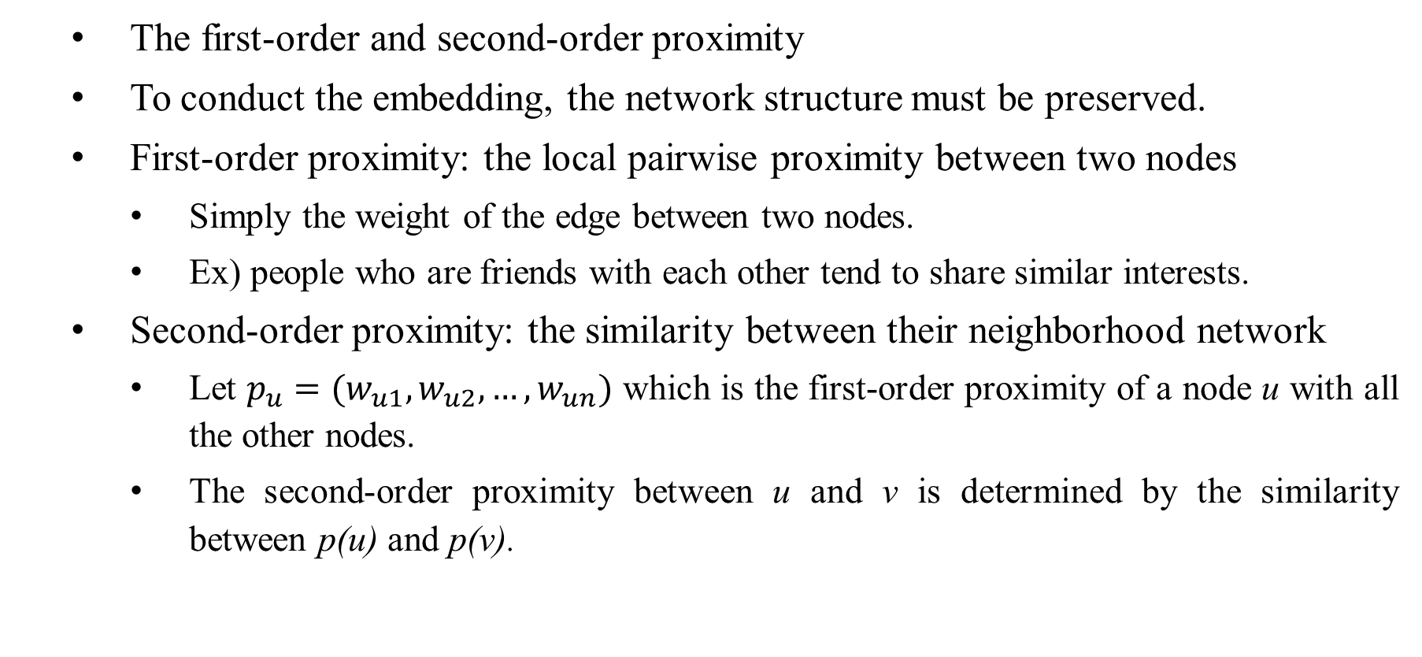
Large-scale Information Network Embedding
The first-order and second-order proximity
To conduct the embedding, the network structure must be preserved.
First-order proximity: the local pairwise proximity between two nodes
Simply the weight of the edge between two nodes.
Ex) people who are friends with each other tend to share similar interests.
Second-order proximity: the similarity between their neighborhood network
Let $p_{u}=(w_{u1},w_{u2},…, w_{un})$ which is the first-order proximity of a node u with all the other nodes.
The second-order proximity between u and v is determined by the similarity between p(u) and p(v).
Notes:
Motivation: nodes may have an arbitrary number of label types, and these label types may be heterogenous

Slide 22
Large-scale Information Network Embedding
Problem: embedding information networks into low-dimensional spaces, in which every vertex is represented as a low-dimensional vector.
Such a low-dimensional embedding is very useful in a variety of applications such as visualization, node classification, link prediction and recommendation.
Notes:
Motivation: nodes may have an arbitrary number of label types, and these label types may be heterogenous

Slide 23
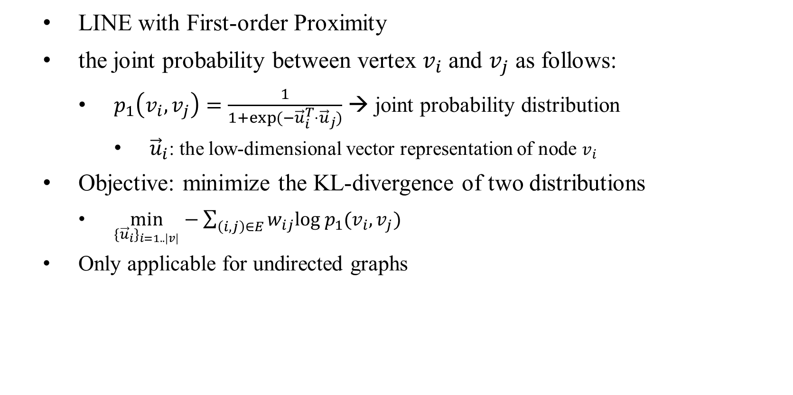
Large-scale Information Network Embedding
LINE with First-order Proximity
the joint probability between vertex $v_{i}$ and $v_{j}$ as follows:
$p_{1}\left(v_{i}, v_{j}\right)=\frac{1}{1+exp(−{\vec{u}}_{i}^{T}⋅{\vec{u}}_{j})}$ → joint probability distribution
${\vec{u}}_{i}$: the low-dimensional vector representation of node $v_{i}$
Objective: minimize the KL-divergence of two distributions
$\min_{{{\{\vec{u}}_{i}\}}_{i=1..|v|}}−\sum_{\left(i,j\right)∈E}{w_{ij}log{ p}_{1}(v_{i}, v_{j})}$
Only applicable for undirected graphs
Notes:
Motivation: nodes may have an arbitrary number of label types, and these label types may be heterogenous

Slide 24



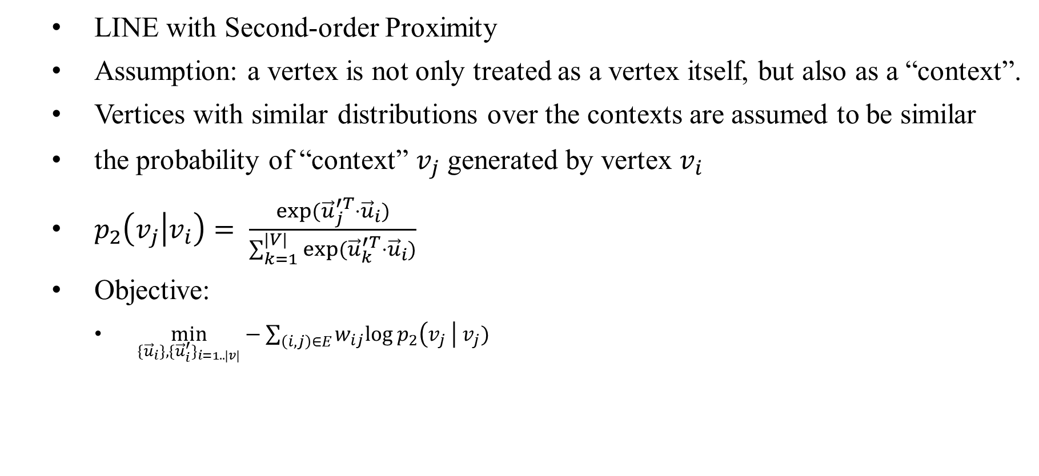
Large-scale Information Network Embedding
LINE with Second-order Proximity
Assumption: a vertex is not only treated as a vertex itself, but also as a “context”.
Vertices with similar distributions over the contexts are assumed to be similar
the probability of “context” $v_{j}$ generated by vertex $v_{i}$
$p_{2}\left(v_{j} | v_{i}\right)= \frac{exp({\vec{u}}_{j}^{′T}⋅{\vec{u}}_{i})}{\sum_{k=1}^{|V|}{exp({\vec{u}}_{k}^{′T}⋅{\vec{u}}_{i})}}$
Objective:
$\min_{{{\{\vec{u}}_{i}\},{\{\vec{u}}_{i}^{′}\}}_{i=1..|v|}}−\sum_{\left(i,j\right)∈E}{w_{ij}log{ p}_{2}\left(v_{j} \right| v_{j})}$
${\vec{u}}_{i}$: vector representation of $v_{j}$ as a vertex
$$v_{j}$$
${\vec{u}}_{i}^{′}$: vector representation of $v_{j}$ as a context
Notes:
Motivation: nodes may have an arbitrary number of label types, and these label types may be heterogenous

Slide 25
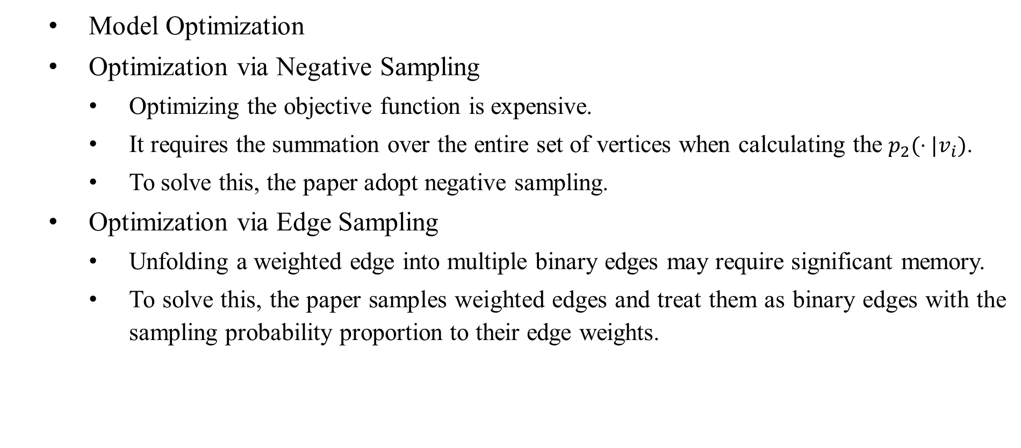
Large-scale Information Network Embedding
Model Optimization
Optimization via Negative Sampling
Optimizing the objective function is expensive.
It requires the summation over the entire set of vertices when calculating the $p_{2}(⋅|v_{i})$.
To solve this, the paper adopt negative sampling.
Optimization via Edge Sampling
Unfolding a weighted edge into multiple binary edges may require significant memory.
To solve this, the paper samples weighted edges and treat them as binary edges with the sampling probability proportion to their edge weights.
Notes:
Motivation: nodes may have an arbitrary number of label types, and these label types may be heterogenous

Slide 26
Learning Graph Representations with Embedding Propagation
Alberto García-Durán and Mathias Niepert (NEC Labs Europe), NIPS, 2017

Slide 27
Embedding Propagation
Embedding Propagation (EP): an unsupervised learning framework for graph-structured data that supports arbitrary label types.
EP learns vector representations (embeddings) of graph by passing messages between neighboring nodes.
Notes:
Motivation: nodes may have an arbitrary number of label types, and these label types may be heterogenous

Slide 28
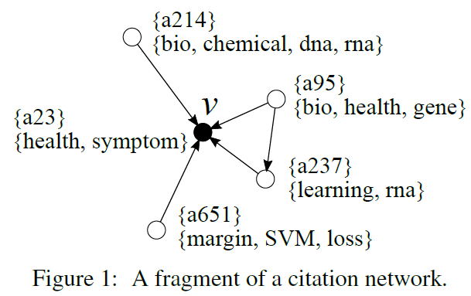
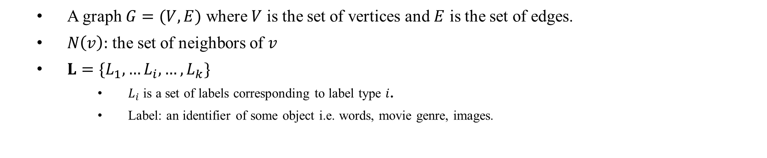
Embedding Propagation
A graph $G=(V, E)$ where $V$ is the set of vertices and $E$ is the set of edges.
$N\left(v\right):$ the set of neighbors of $v$
$L=\{L_{1},…L_{i}, …, L_{k}\}$
$L_{i}$ is a set of labels corresponding to label type $i$.
Label: an identifier of some object i.e. words, movie genre, images.

Slide 29
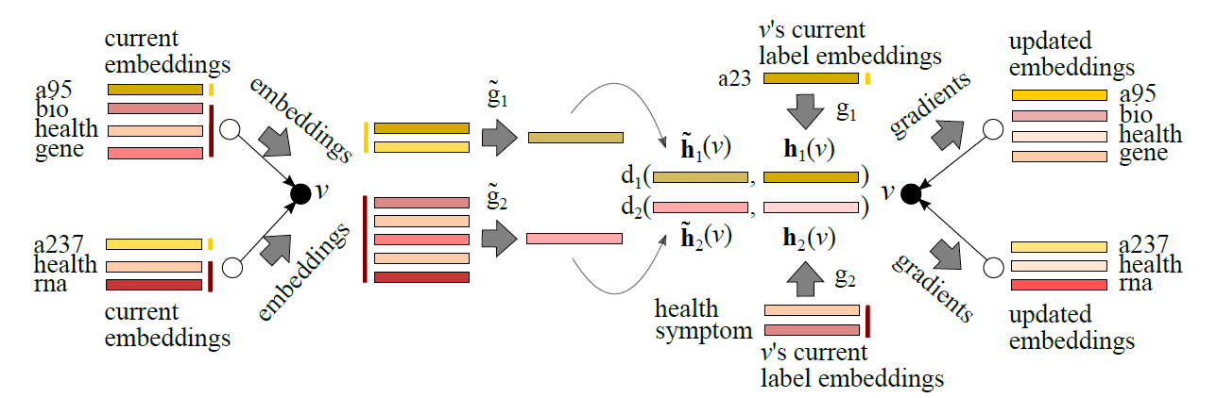
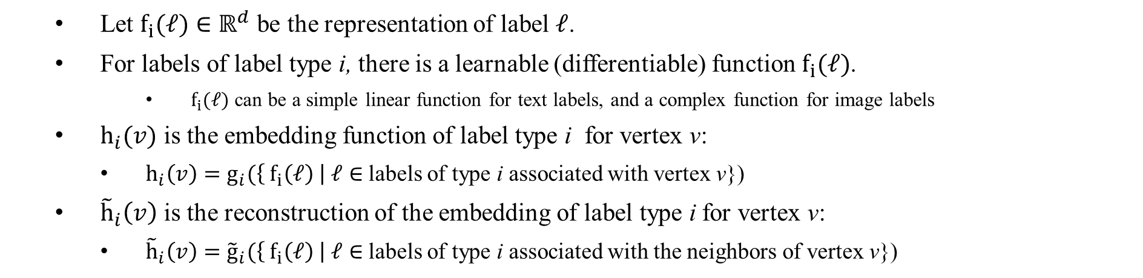
Embedding Propagation
Let $f_{i}(ℓ)∈ℝ^{d}$ be the representation of label $ℓ$.
For labels of label type i, there is a learnable (differentiable) function $f_{i}(ℓ)$.
$f_{i}(ℓ)$ can be a simple linear function for text labels, and a complex function for image labels
$h_{i}(v)$ is the embedding function of label type i for vertex v:
$h_{i}\left(v\right)=g_{i}(\left\{ f_{i}\left(ℓ\right) \right| ℓ∈$ labels of type i associated with vertex v})
${\tilde{h}}_{i}\left(v\right)$ is the reconstruction of the embedding of label type i for vertex v:
${\tilde{h}}_{i}\left(v\right)={\tilde{g}}_{i}(\left\{{ f}_{i}\left(ℓ\right) \right| ℓ∈$ labels of type i associated with the neighbors of vertex v})
Notes:
각 레이블을 어떻게 뭉치는 지는 (함수 f를 어떻게 설계하는 지는 사용자가 결정)
레이블 별로 f라는 함수를 통해 vector embedding 만들어서, g라는 함수를 통해 하나로 합친 결과가 h
f와 g는 모두 미분가능, 많은 경우에서 g랑 g_hat은 parameter free function; element-wise avg, max

Slide 30

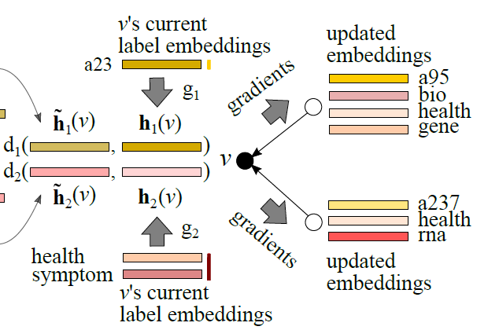
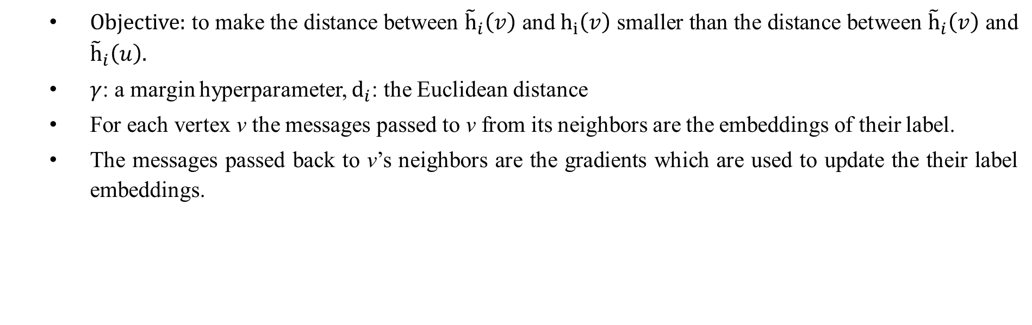
Embedding Propagation
Objective: to make the distance between ${\tilde{h}}_{i}\left(v\right)$ and $h_{i}\left(v\right)$ smaller than the distance between ${\tilde{h}}_{i}\left(v\right)$ and ${\tilde{h}}_{i}\left(u\right).$
$γ$: a margin hyperparameter, $d_{i}$: the Euclidean distance
For each vertex v the messages passed to v from its neighbors are the embeddings of their label.
The messages passed back to v’s neighbors are the gradients which are used to update the their label embeddings.
Notes:
The objective is to make the distance between ${\tilde{h}}_{i}\left(v\right)$ and $h_{i}\left(v\right)$ smaller than the distance between ${\tilde{h}}_{i}\left(v\right)$ and ${\tilde{h}}_{i}\left(u\right).$
Gradient를 어떻게 전달시켜서 업데이트하는지는 안나와있음

Slide 31
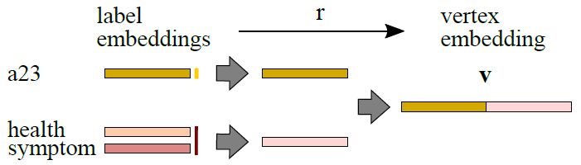
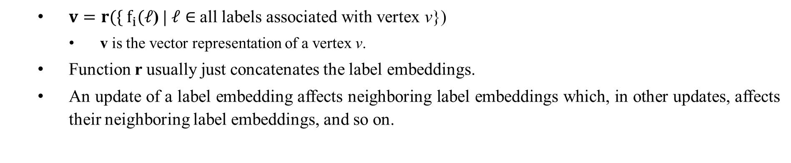
Embedding Propagation
$v=r(\{ f_{i}(ℓ$) | $ℓ∈$all labels associated with vertex v})
v is the vector representation of a vertex v.
Function r usually just concatenates the label embeddings.
An update of a label embedding affects neighboring label embeddings which, in other updates, affects their neighboring label embeddings, and so on.
Notes:
The objective is to make the distance between ${\tilde{h}}_{i}\left(v\right)$ and $h_{i}\left(v\right)$ smaller than the distance between ${\tilde{h}}_{i}\left(v\right)$ and ${\tilde{h}}_{i}\left(u\right).$

Slide 32

Embedding Propagation
EP-B: an instance of EP framework found to be effective several of the typical graph-based learning problems.
Hyperparameters of EP framework: $f_{i}$, $g_{i}$, ${ \tilde{g}}_{i}$, r
$f_{i}$ ← linear embeddings equivalent to an embedding lookup table.
$g_{i}$ and ${ \tilde{g}}_{i}$ ← element-wise average
r ← concatenation of the label embeddings
Notes:
Gradient step을 한 번만 해도 어차피 다른 노드에서 할 때 또 바뀜

Slide 33
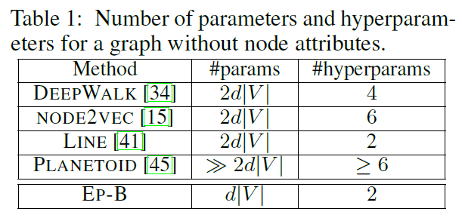
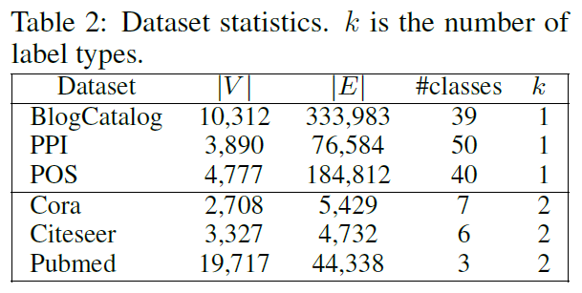
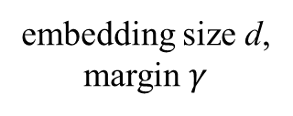

Experiments
Evaluation by node classification problem
d is fixed to 128 for all methods
$γ$ is chosen from [1, 5, 10, 20] via cross validation
2
2
2
1
1
1
embedding size d, margin $γ$
Notes:
BlogCatalog (online social net.), PPI (protein-protein interactions), POS (Wikipedia)
Multi-label classification
Cora, Citeseer, Pubmed
One label per node

Slide 34
Experiments
Evaluation by node classification problem
Input: a graph
A fraction of the nodes is assigned a class label
The output is an assignment of class label to the test node
The paper choose logistic regression trained with node representations v.
Notes:
BlogCatalog (online social net.), PPI (protein-protein interactions), POS (Wikipedia)
Multi-label classification
Cora, Citeseer, Pubmed
One label per node

Slide 35

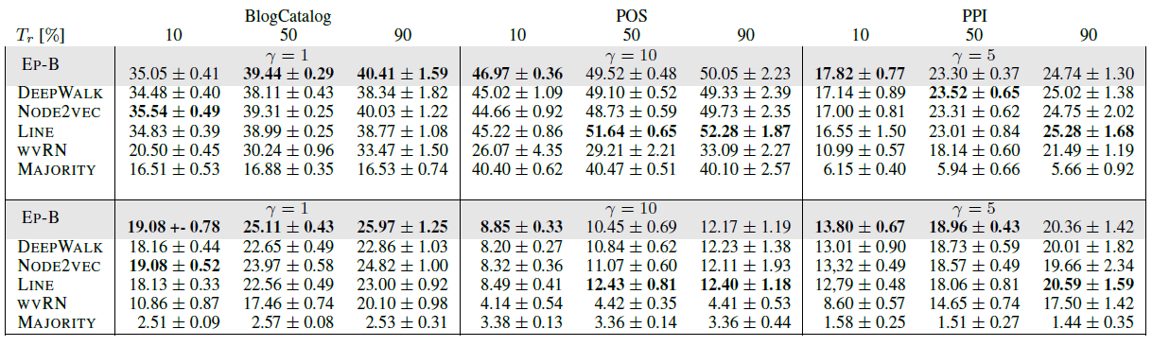

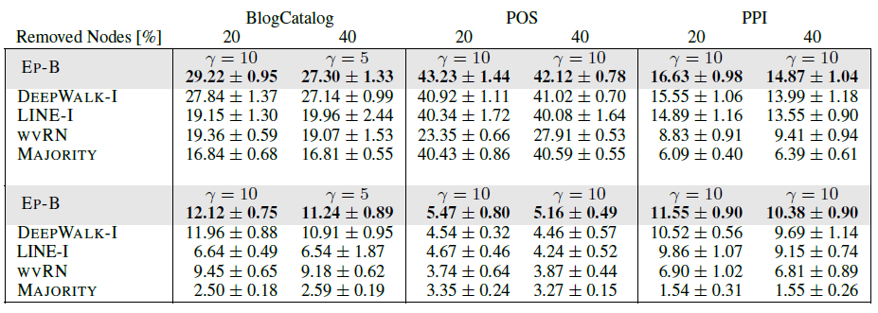
Experiments: multi-label classification
Notes:
Node2vec 논문에서 주장한 바와는 달리 node2vec이랑 deepwalk이랑 큰 차이 없음
Transductive: 모두 사용, inductive: 트레이닝에서 일부 제거

Slide 36
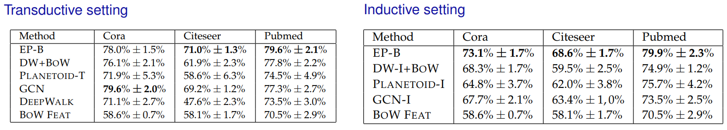
Experiments: single-label classification
Notes:
BlogCatalog (online social net.), PPI (protein-protein interactions), POS (Wikipedia)
Multi-label classification
Cora, Citeseer, Pubmed
One label per node

Slide 37
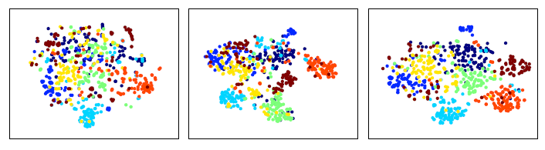
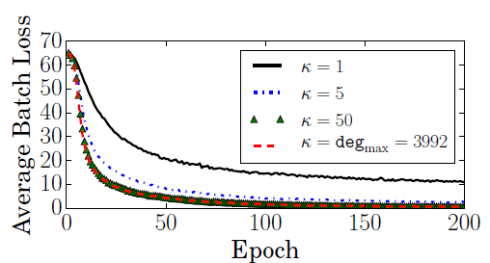
Experiments: visualization and number of neighbors
Identity labels only
Word labels only
Both
Silhouette score s
(-1 < s < 1)
0.008
0.107
0.158
Notes:
s 가 1에 가까울수록 clustering이 잘 됨
딱히 잘된 것 같진 않으나 레이블이 추가되어서 클러스터링이 더 잘 된 것을 볼 수 있음
임베딩 학습 시 이웃 수를 5개 정도로 제한하면 효율적으로 학습 가능

Slide 38
Conclusion and Future Work
Contribution:
Ability to learn arbitrary label type representations and combine them into a joint vertex embedding.
EP-B method is competitive and often outperforms the other state of the art methods with fewer parameters and hyperparameters.
Future work:
Incorporates with image and sequence data
Multi-relational graphs

Slide 39
Ideas

Slide 40
Idea
Evaluate each embedding method by the result of clustering instead of node classification problem.
Spectral clustering (Min. Normalized Cut) vs. Clustering (k-means)
The objectives the methods are proved to be equivalent.
Find how to solve traditional problems of network data where graph-structured data have been used with the vector representations of graph data.
Link prediction, Information Propagation, Recommendation, Graph Sampling, …
See what happens if we convert the vector embeddings back to a graph.
Distances between vectors would be the edge weights between nodes.
See whether a convergence happens when two steps are repeated.

